Slide 1

Personal Safety Issues for Online Sex Ed
Barri Rosenbluth, Expect Respect Program, SAFE Alliance, Austin, Texas

Slide 2
Goals
Make it safer for students to share experiences with you and each other
Respond in ways that are supportive and protective and that build community
Promote healthy, consensual relationships

Slide 3
“Shelter” in Place
What is the range of experiences young people may be having right now in their homes?
Best__________________________________________________Worst
Notes:
This next section explores some of the forms of violence children experience and theirimpact.

Slide 4
Children’s Exposure to Violence
  41% were physically assaulted in the last year
  13% were harmed by a parent or caregiver
  22% witnessed family and community violence
  10% of girls 14-17 experienced sexual assault or abuse
  More than 13% were physically bullied, 30% emotionally bullied
  15% six or more incidents in the past year
  5% ten or more incidents in the past year
  National Survey on Children’s Exposure to Violence, Finkelhor et al., 2013)
Notes:
Most of our clients have histories of exposure to violence. Each year nearly half of all children are exposed to some form of violence. The impact is cumulative. Children who have multiple exposures have the worst outcomes, problems with health, mental health, behavior, school performance and relationships. Increased risk for future victimization and perpetration.

Slide 5
Domestic Violence:
How Children are Involved
Seeing, hearing and being physically hurt or threatened
Being used by the abusive person in the act of violence
Living in constant fear
Seeing parent injured/needed to get help
Seeing police intervene/remove abusive partner
Needing to flee/move constantly
Assuming protective role in the family
Not feeling safe, learning how to identify or express feelings, handle stress/conflict

Slide 6
Corporal Punishment
By the time they reach 5th grade, 80% of American children report that they have been spanked by their parents (Gershoff & Bitensky, 2007; Vittrup & Holden, 2010).
Linked to increased aggression, mental health problems, difficult relationships with parents, lower self-esteem and lower academic performance (Gershoff & Grogan-Taylor, 2016).
The majority of physical abuse cases start with corporal punishment.
Notes:
Most pervasive form of family violence

Slide 7
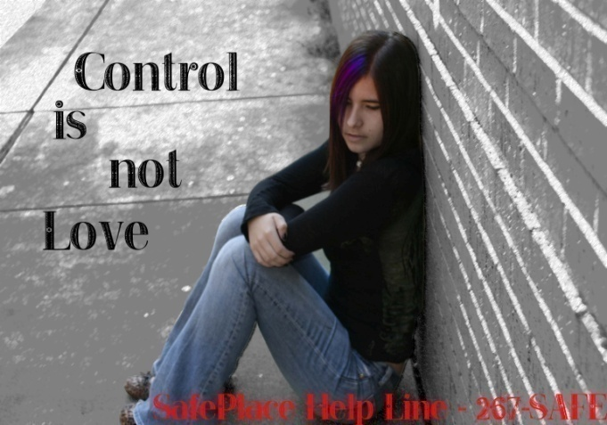
Dating Abuse
Insults, name-calling, put downs
Jealous and controlling behavior
Using technology to harass or intimidate
Isolation from friends/family
Threats to hurt self or others
Hitting, choking, kicking, restraining
Forced/coerced sexual activity
Interfering with birth control
Using children and visitation to hurt or control partner
Notes:
7
Children who are exposed to DV are at increased risk for abuse in their peer and dating relationships. They have learned that hurtful and controlling behaviors are acceptable and they HAVE NOT learned the skills and trust required for healthy relationships. Communication, expressing feelings, resolving conflict, balancing power, setting and respecting limits and boundaries.

Slide 8
Creating a Safe Online Space
Acknowledge that many young people have experienced abuse in their homes and in their relationships. Invite students to reach out to you or others. Provide local help info to everyone.
In Austin area:
24-hr SAFEline - Call: 512.267.SAFE (7233),Text: 737.888.SAFE (7233) Chat: safeaustin.org/chat
For Deaf, DeafBlind, DeafDisabled, Late-Deafened, and Hard of Hearing people, please use relay/VRS.
911 for emergencies

Slide 9
Continued
2. Clarify limits to confidentiality at the start. “If you tell me…I will need to contact authorities to help you stay safe. If I’m concerned about your safety, I will try to speak with you in private first so that so we can make a plan.”
3. Use “people first” language. Avoid labels like “victim” or “abuser.” Say, “Teens who have experienced abuse…, People who pressure or coerce…”
5. Be mindful when talking about sex that many teens will have already had non-consensual sex and that saying “No” is not always an option.

Slide 10
Break-out Question
How does being mindful that some students have experienced sexual abuse or non-consensual sex impact your approach to sex ed. What, if anything, might you do differently from this perspective?

Slide 11
Synchronous Disclosures
Allow student to finish.
Validate feelings and decision to disclose.
Don’t ask questions about the incident.
“Is there anything you need to hear right now from people in this class?”
Allow time for sharing—this is really important.
Model and encourage support by others, ask for respect for privacy.
Ask to speak privately after class.
“Would you like to take a break before we move on?”

Slide 12
Asynchronous Disclosures
Ask to speak privately on the phone.
Validate feelings and decision to disclose.
Review your responsibility to report abuse. Ask for any questions.
Listen. Don’t investigate.
Ask what you can do to help.
Explain your next steps. Schedule a follow up call to assess safety.
Provide local help resources and 911.

Slide 13
Report Abuse in Texas
https://www.dfps.state.tx.us/Contact_Us/report_abuse.asp
By Phone: 1-800-252-5400
Online: Texas Abuse Hotline
Call our Abuse Hotline toll-free 24 hours a day, 7 days a week, nationwide, or report with our secure website and get a response within 24 hours.
Call your local law enforcement agency or 911 immediately if you have an emergency or life-threatening situation.
In families where battering occurs, the rate of child abuse or neglect is 15 times higher than the national average. Children may be hurt indirectly when their parent is abused. They may be injured trying to protect their parent.

Slide 14



Resources
Consent for Kids
https://www.jwi.org/tools/
https://www.youtube.com/watch?v=h3nhM9UlJjc
Expect Respect Program Manual
Promoting Safe and Healthy Relationships for Youth www.safeaustin.org/expectrespect
Notes:
This next section explores some of the forms of violence children experience and theirimpact.

Slide 15
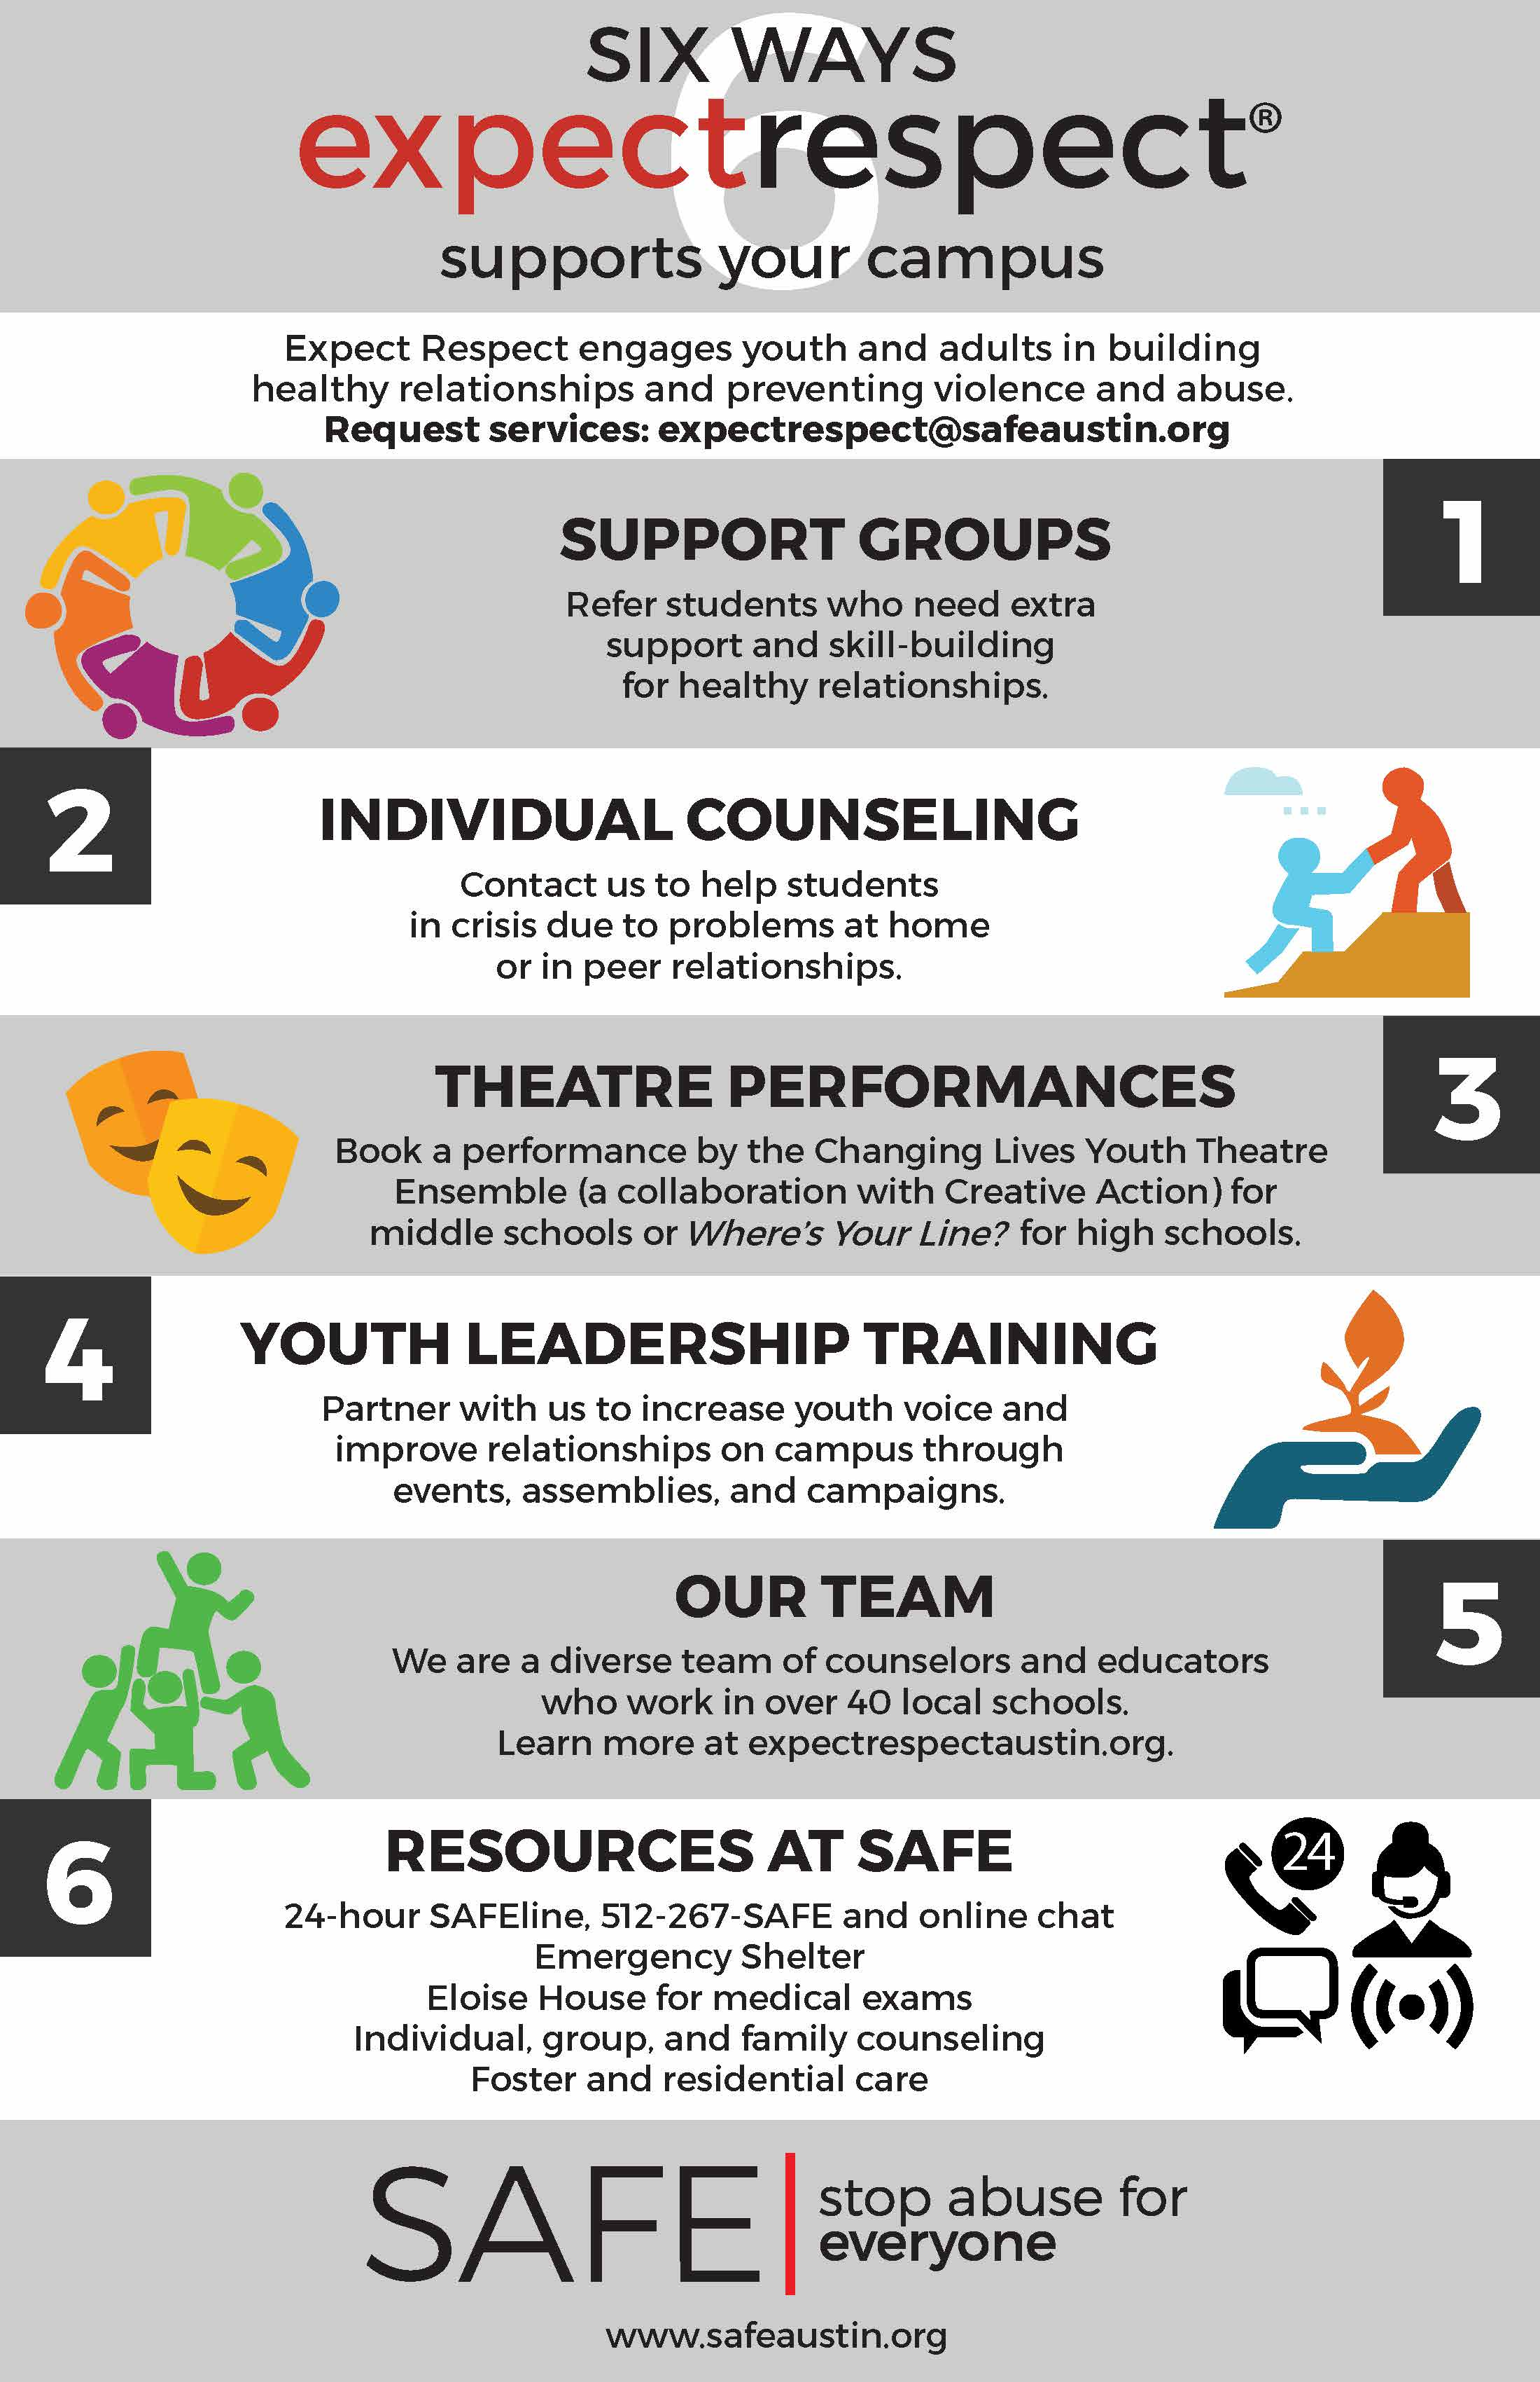

In Austin Area
Notes:
Greeting, thank you and introductions

Slide 16
Thank You!
Barri Rosenbluth
Senior Director, Expect Respect
(512) 356-1628
brosenbluth@safeaustin.org
www.safeaustin.org/expectrespect

